Slide 1
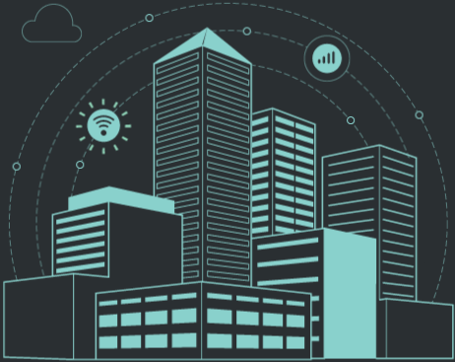
WELCOME
Traffic
Stimulator

Slide 2
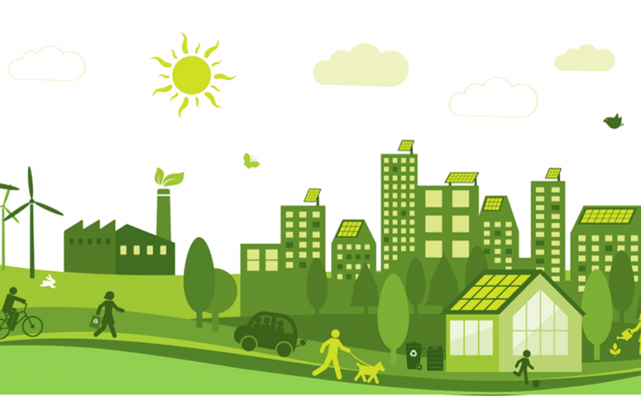
Elevator Pitch
TRAFFIC STIMULATOR

Slide 3
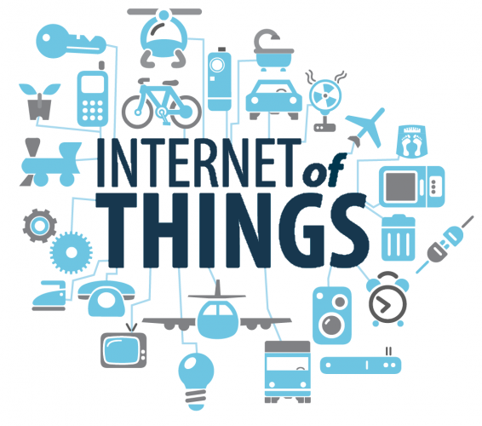
ABSTRACT
IoT (Internet of Things) is the network of physical objects-devices, vehicles, buildings and other items embedded with electronics, software, sensors, and network connectivity-that enables these objects to collect and exchange data. The internet of things allows objects to be sensed and controlled remotely across existing network infrastructure. According to the Gartner, 260 million objects will be connected by year 2020. Several companies and governments have tried to make references with IoT in initial times, but nowadays in manufacturing, retail and SOC (Social Overhead Capital) industries, successful best practices are built recently. In this paper, I summarized tangible IoT based service models which are helpful to academic and industrial world to understand IoT business.

Slide 4
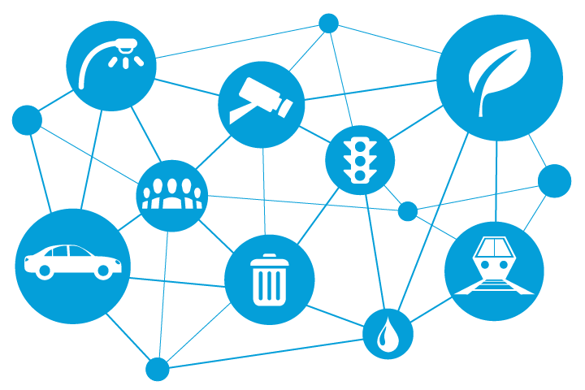
INTRODUCTION

Slide 5
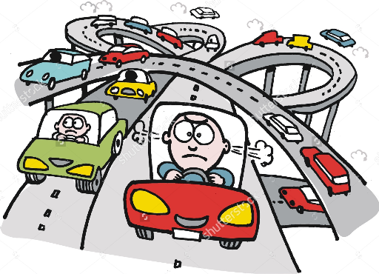
WHY
TRAFFIC
STIMULATOR

Slide 6
So??? How does this work???
Sonar 3
Sonar 2
Sonar1
Receiver
Checks for which lane with more vehicles
Receives data from the sonar
Lane 2
Lane 1

Slide 7
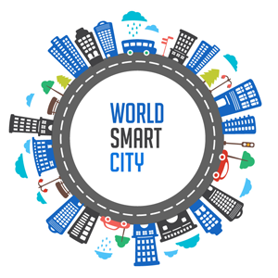
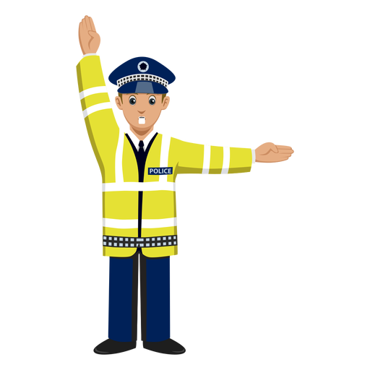
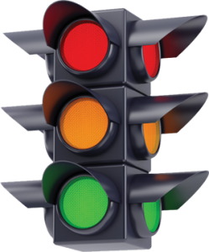
Traffic Stimulator implementation model

Slide 8
Lane 1
Sonar 1
Sonar 2
Sonar 3
Camera
Sonar for pedestrian
Signal for lane1
Street Lights
Micro Controller
Arduino mega and UNO
Camera and color sensor
Signal for lane 2
Sonar for pedestrian
Traffic Department
Sonar 1
Sonar 2
Sonar 3
Lane 2

Slide 9
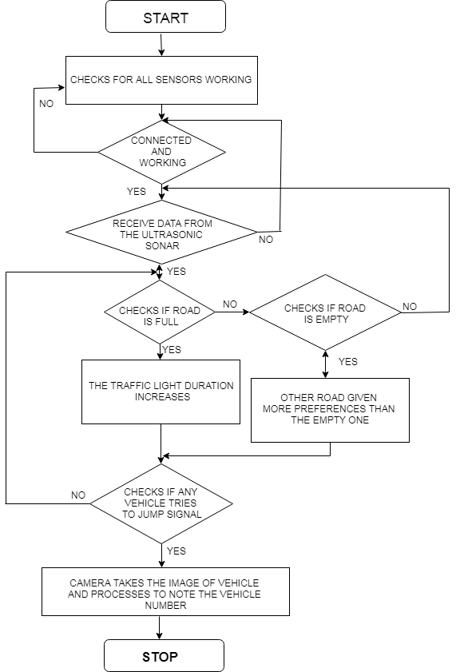
Flow of Working

Slide 10
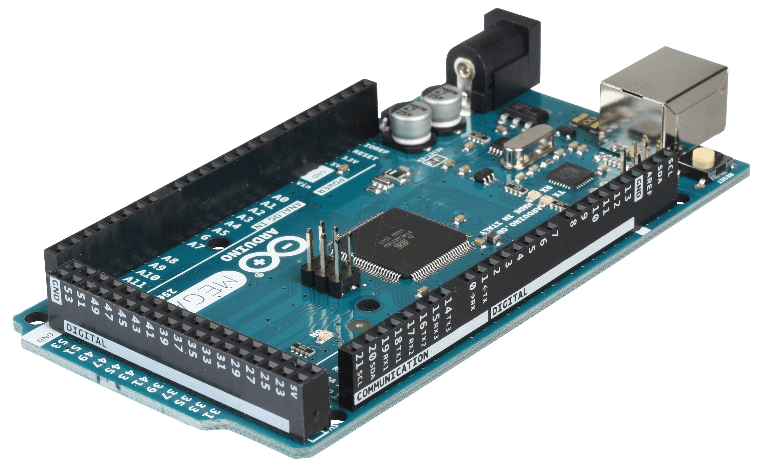
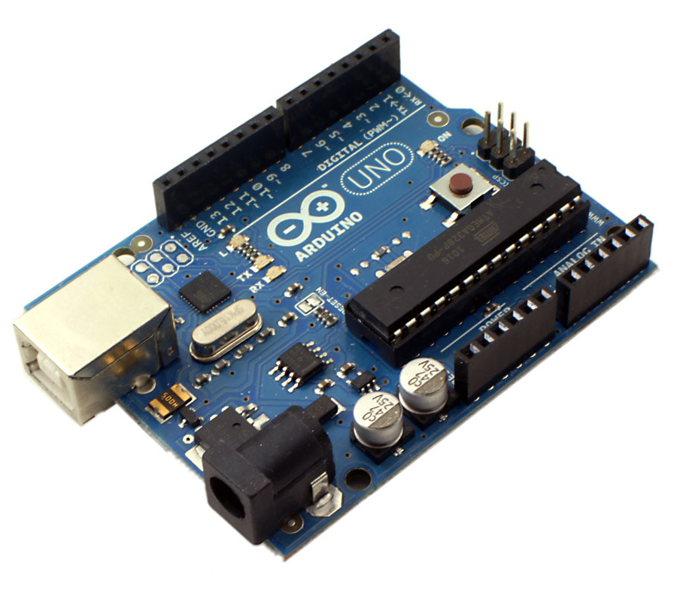
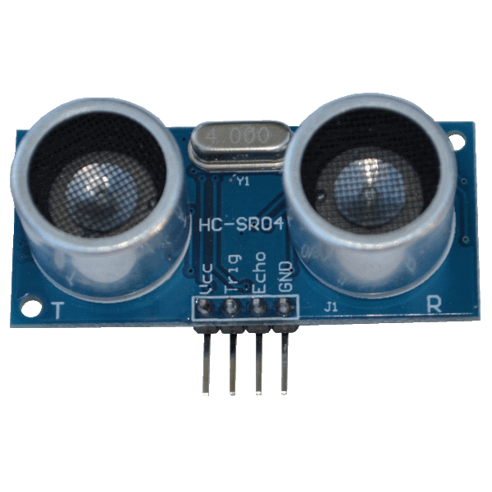
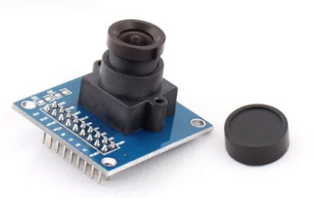
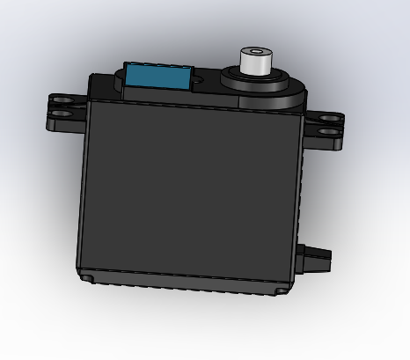
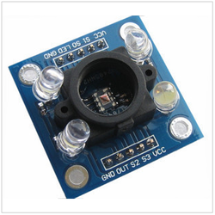
Sensors to be used:
Arduino Mega
Arduino UNO
Ultrasonic Sensors
Camera Modules
Digital display/Seven segment display
Led lights
LDR(light dependent resistance)
Servo motors
Color sensor

Slide 11
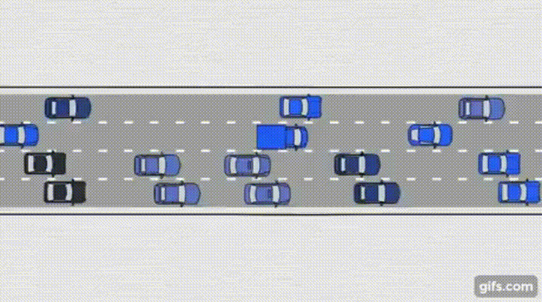
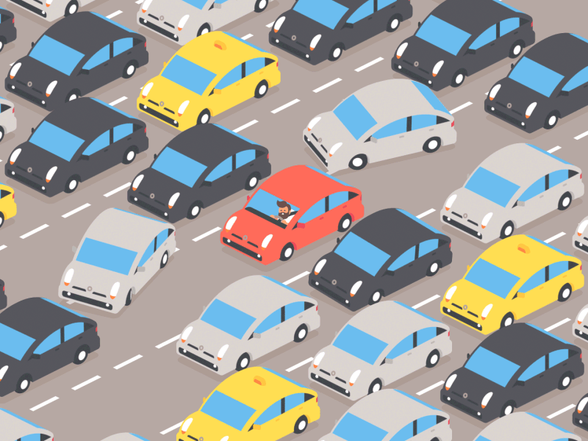
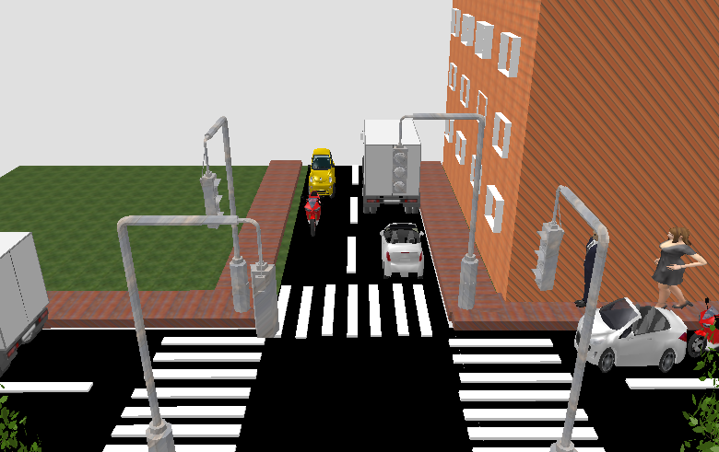
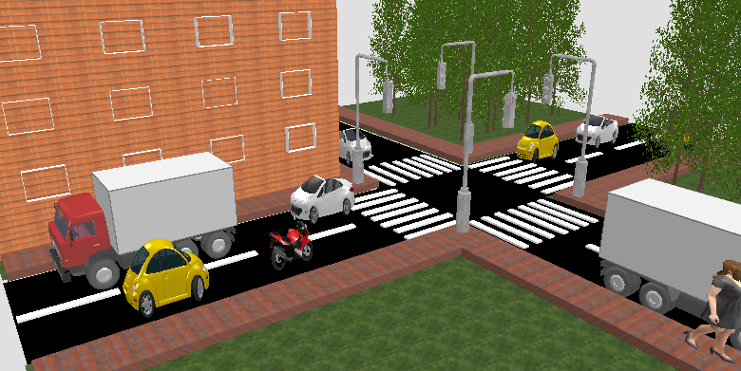
Merits:
1- stepping ahead to build a smart city.
2- It reduces the man power.
3- cost effective and efficient.

Slide 12
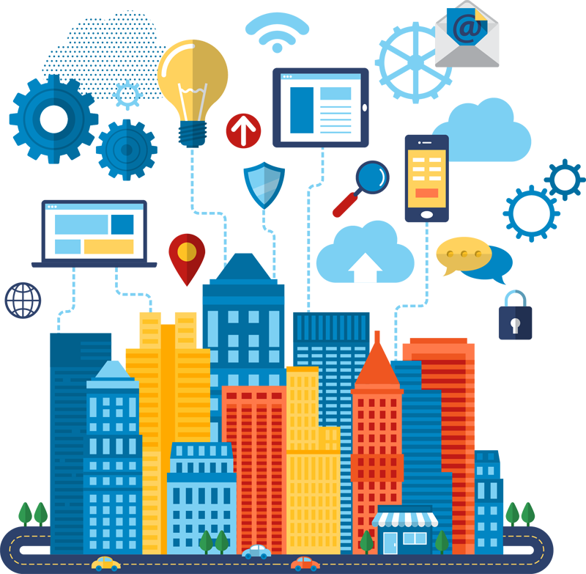
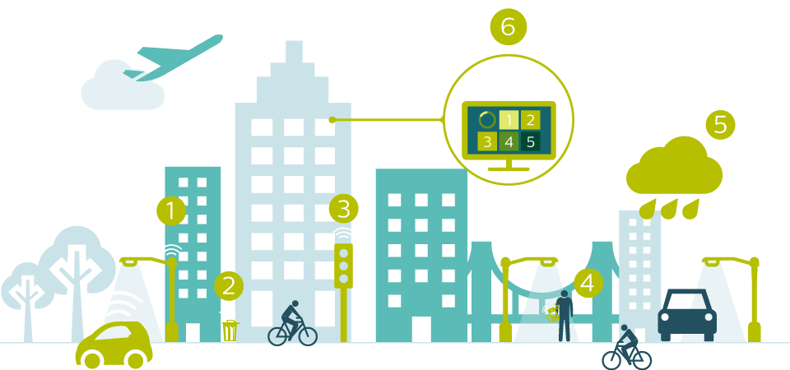
Conclusion

Slide 13
THANK YOU

